Slide 1
A Song of Ice & Fire
A brief History of Westeros & Essos

Slide 2
CORRESPONDING DATASETS | QUESTIONS
HOUSES
BY REGION, CURRENT LORD, HEIR, OR IF THE HOUSE HAS DIED OUT
FOR CURRENT LORDS OR HEIRS, THE ROW REFERS TO THE LINE IN CHARACTER CSV
CHARACTERS
BY CULTURE, TITLE, HOUSE, ALIASES, BIRTH, DEATH, & ALLEGIANCES
ALLEGIANCE CELLS REFER TO THE LINE NUMBER OF THE CHARACTER
QUESTIONS:
HOW ARE THE CHARACTERS RELATED TO EACH OTHER - BY WAY OF BLOOD OR ALLIANCES.
WHAT HOUSES BELONG IN WHICH REGION & HOW MANY?
WHO IS THE CURRENT RULER IN EACH MAJOR CITY OF WESTEROS & ESSOS?

Slide 3
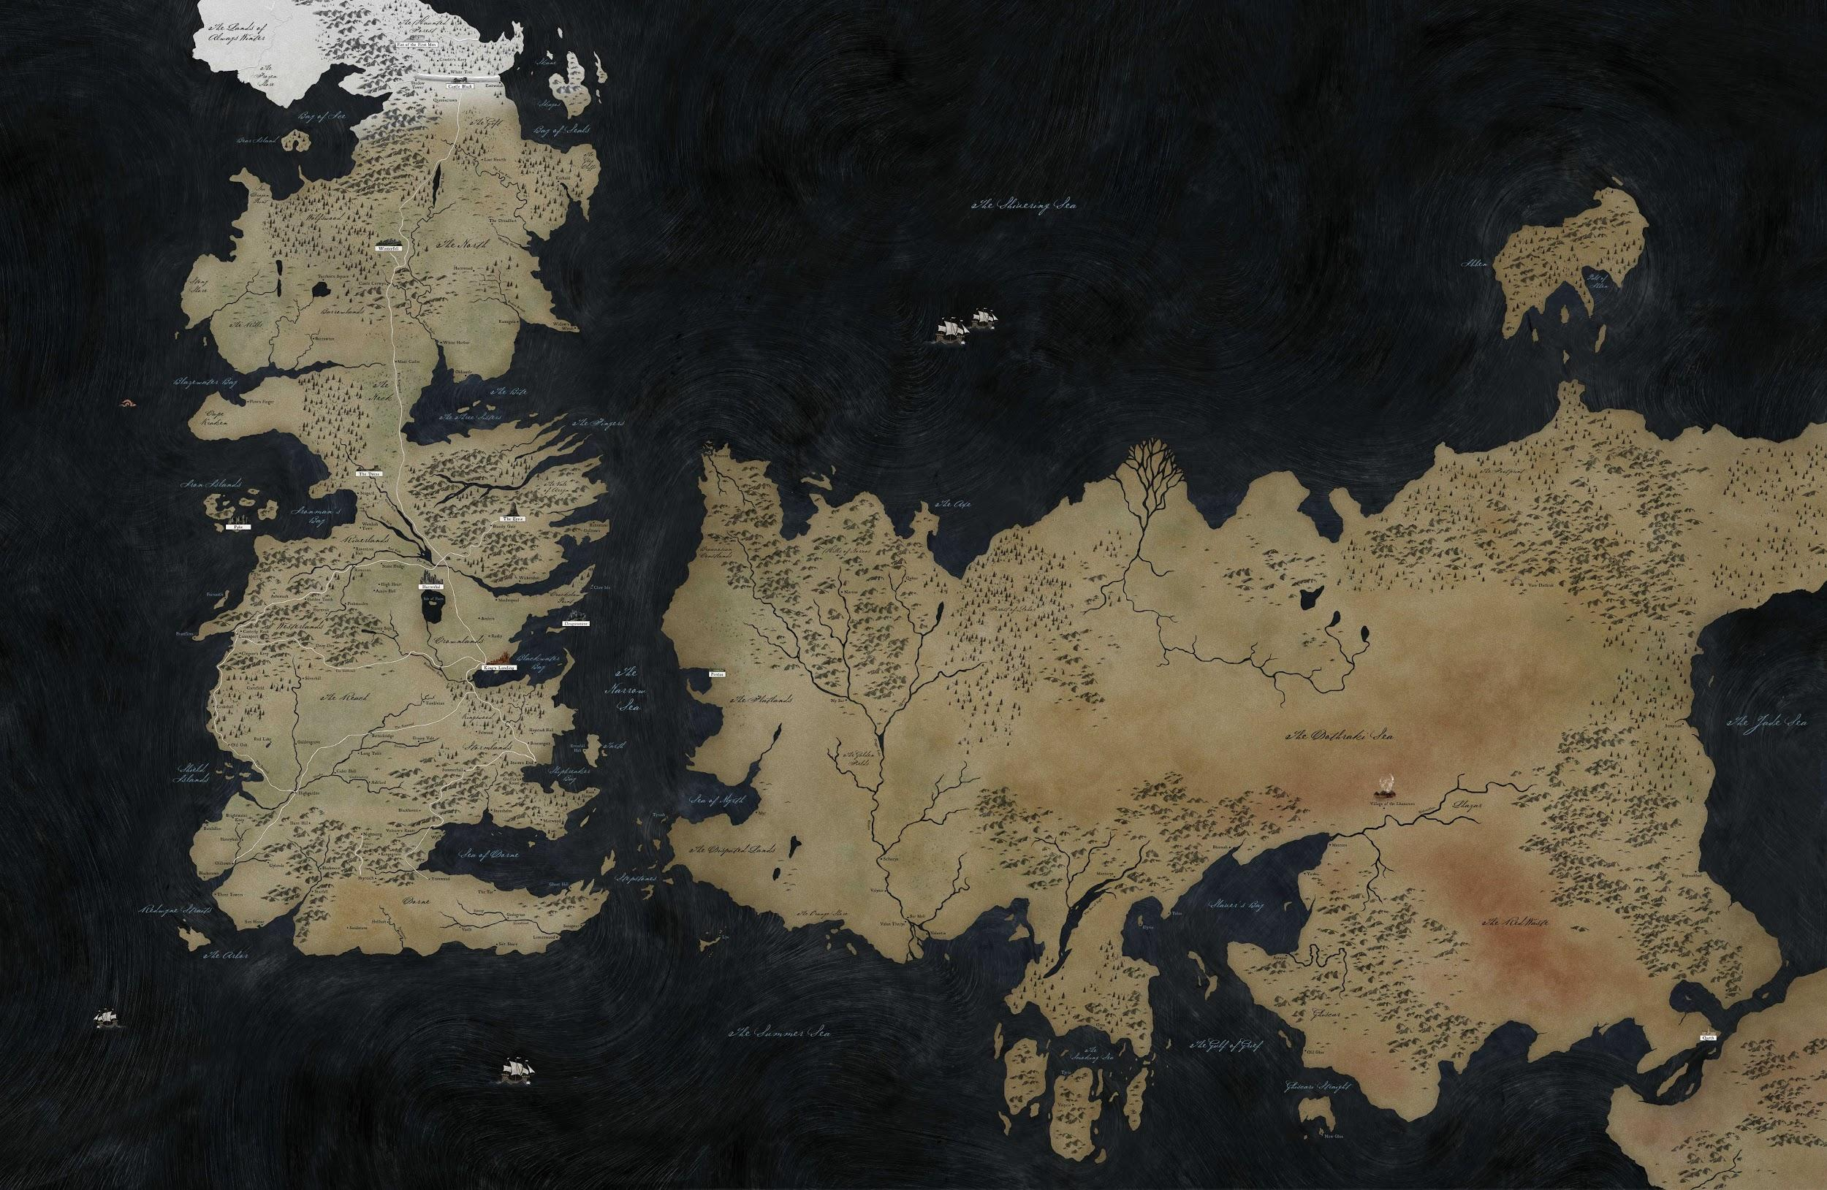
DATA VISUALIZATIONS
CURRENT
HOUSES/PER REGION
BOOK APPEARANCES/CHARACTER

Slide 4
REALISTIC PROJECT GOALS
INTERACTIVE MAP THAT DISPLAYS REGIONS WITH HOUSES AS TOOLTIPS
INTERACTIVE FAMILY TREE WITH CHARACTER BRANCHES THAT DISPLAY LINEAGE & ALLIANCES
ROADBLOCKS
DECONSTRUCTING CARTO MAP INTO LAYERS
CODING TREE MAP

